Slide 1
Survey on Driverless Vehicles
By: Unity Gardner, Jared Caldwell, Logan Martinez, Christian Watkins

Slide 2
What are Autonomous Vehicles?
AVs, otherwise known as Autonomous Vehicles are cars or trucks that can perform without a person operating them.
AVs work with a combination of cameras, sensors, motors, and software that record roads and environment to accurately drive and function.
Their applications can be public or private, but have the objective to make roadways and operations more efficient and safe.

Slide 3
Levels 0-2 of AV’s
Level 0: No Automation
Entirely reliant on a person operating
Level 1: Driver Assistance
A person is driving, but a system can take control of speed or guidance
Level 2: Some Self Driving
The vehicle’s system can takeover both speed and control

Slide 4
Levels 3-5 of AV’s
Level 3: Conditional Automation
The vehicle can be in full control in some conditions
Level 4: Full self-driving (with exceptions)
The vehicle is under full control but in specific safe environments
Level 5: Full self-driving (in all conditions)
The vehicle is under full control in all situations and all environments, no driver

Slide 5
Sensors levels 1 and 2 of AV
(1)Awareness driving- allows vehicles to know eachothers locations and pass along hazard information.
(2)Sensing driving- enables vehicles to provide information captured by sensors in the vehicle and use this information to have accurate knowledge of their surroundings.

Slide 6
Sensors at levels 3-5 of AV
(3)Cooperative driving- permits vehicles to share intended future actions with other vehicles such as destinations and maneuvers.
(4&5)Synchronized cooperative driving - Accident-Free Driving- vehicles capable of driving autonomously under any scenario, synchronizing trajectories and optimal driving patterns

Slide 7
Common Problems
Sensors and Computing
A system has to record information and respond very quickly, this can be difficult to process in a timely manner.
Vehicle-to-Vehicle Communication
Lots of development is needed for vehicles to communicate and react to each other.
Ethical Questions
Dilemmas may present themselves on the road and a system may have to morally weigh what to hit or avoid. Leaving a program responsible for lives is incredibly challenging.

Slide 8
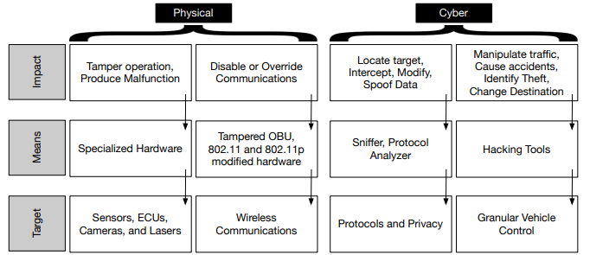
Different types of attacks

Slide 9
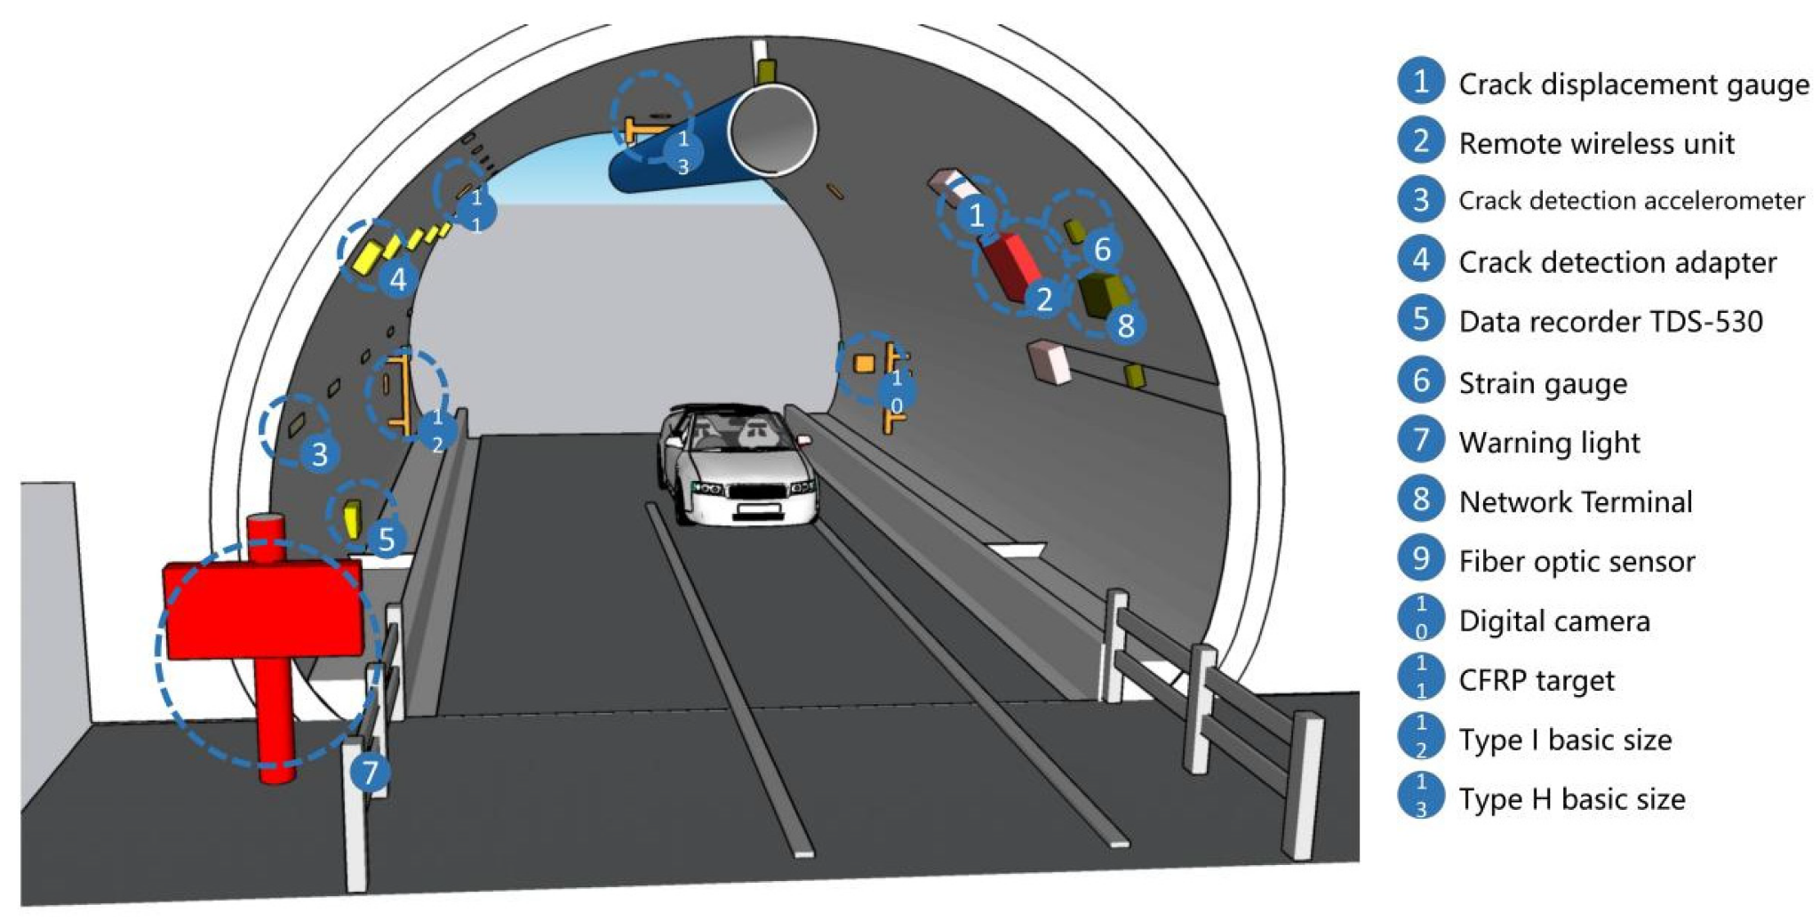
Infrastructure Accommodations
Why changes are needed
Autonomous vehicles will need to communicate via sensors to get updates on road condition while being able to send out warnings about potentially unsafe conditions.
Closed in spaces would need additional sensors to ensure safety for all passengers with being able to detect more around them.

Slide 10
World Improvements
Essential Improvements
Everybody will have freedom of mobility even those who might not have been able to drive due to disabilities.
Will provide a significant reduction in the number of people killed in traffic accidents while giving more time to work, relax, or sleep during the hands off ride.

Slide 11
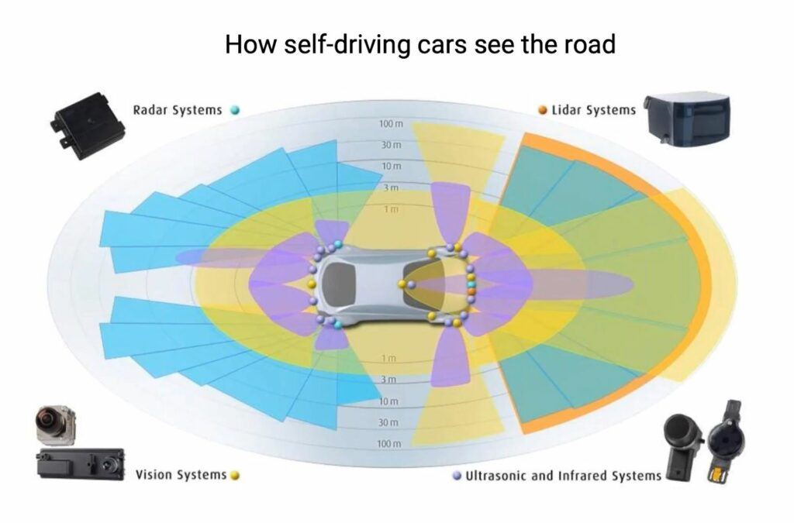
Technology in Autonomous Vehicles
Autonomous Avs have a ton of technology to determine how it moves and sees the world around it.
Examples include:
LiDAR
Cameras
GPS
Radar
a ton of sensors
and of course an algorithm to control the vehicles functions like braking.
There is so much technology in these things to try and make them safe and practical.

Slide 12
Sensor functions
LiDAR(Light Detection and Ranging)- emits light pulses that reflect objects to generate a three-dimensional map of the surrounding environment.
VLC(Visible Light Communication)- wireless communication using LEDs to transmit data by modulating light at imperceptible speed
Ultrasonic Ranging Devices (URD)- senses objects around the vehicle
Millimeter Wave Radar- uses electromagnetic waves to detect speed, distance, and angle

Slide 13
More about sensor functions
Infrared Ranging- assists with 3d mapping with night vision and thermal imaging
Ultrasonic Ranging Devices (URD)- senses objects around the vehicle
Millimeter Wave Radar- uses electromagnetic waves to detect speed, distance, and angle
Infrared Ranging- assists with 3d mapping with night vision and thermal imaging

Slide 14
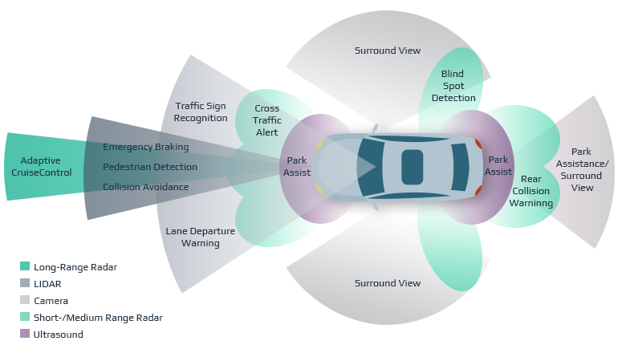

Slide 15
Positioning functions
GPS(Global Positioning System)- enables the vehicle to know its exact location at all times.
Doppler Radar Speedometers- works in all weather conditions and calculates the velocity of moving objects even being able to differentiate between pedestrians, cyclists, and other vehicles

Slide 16
More about positioning functions
Radar Cruise Control- increases safety to detect distance from objects and maintain the safe distance from objects
Radar Based Obstacle Detection Systems- provides reliable detection of all obstacles while able to differentiate between what the objects may be in all weather conditions

Slide 17
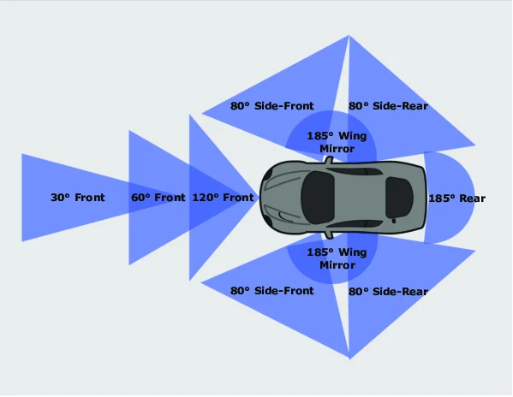
A little more about Vision in Autonomous Vehicles
AVs usually contains a decent amount of cameras to detect the world around it, they are placed all around the vehicle to avoid having any blind spots. The cameras help detect things like traffic lights, lane markings and road signs.
Typical camera set up for an AV.(May Vary)

Slide 18
Network functions
VANET’s(Vehicular Ad-Hoc Networks)- enables safer and more accurate and effective communication about navigation
Automotive Ethernet- transfers data between LiDAR, cameras, radar, AI compute platforms, and actuators

Slide 19
More about network functions
Byteflight- provides fault-tolerance, high speed data transfer, and utilizes optic fibers to avoid interference
Controller Area Network (CAN)- enables interconnection between electronic control units and prioritizes safety and high-priority messages

Slide 20
More about network functions
FlexRay- supports active steering while ensuring precision timing and reliable for safety-critical components.
Local Interconnect Network (LIN)- low-speed communication for non-safety-critical data acting as a secondary network to the CAN

Slide 21
More about network functions
Low-Voltage Differential Signaling (LVDS)- facilitate high speed reliable data transmission for sensors, cameras, and displays while minimizing power consumption
Media Oriented Systems Transport (MOST)- provides a high-bandwidth low latency network for large amounts of sensor data

Slide 22
Questions?

